Slide 1

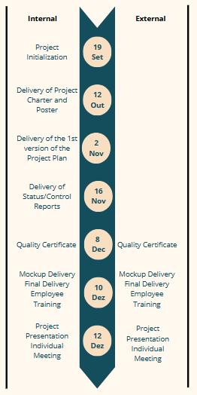
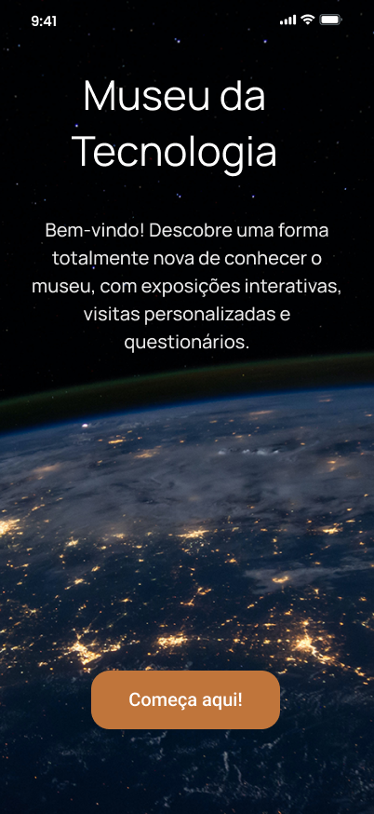
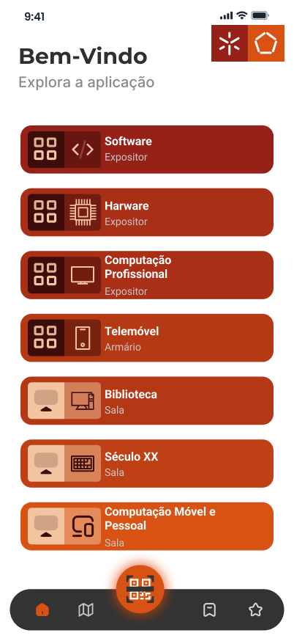
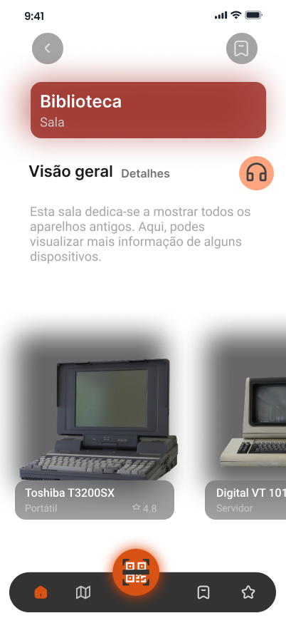


Gestão de Projetos de Tecnologias e Informática (GPTI)
Engenharia de Telecomunicações e Informática
Departamento de Sistemas de Informação - Escola de Engenharia
IT MuseUM App
Project Team: Catarina Pereira, pg53733@alunos.uminho.pt | Inês Neves, pg53864@alunos.uminho.pt | Leonardo Martins, pg53996@alunos.uminho.pt | Rodrigo Rocha, e12164@alunos.uminho.pt
Project proponent: GPTI | Lecturer: João Varajão
Framework
As part of the Information Technology Project Management course, the IT MuseUM application project was carried out. The project focuses on the rapid technological evolution of smartphones, devices that have become central to modern life. As smartphones and computers evolve, older models become obsolete, emphasising the importance of preserving their history. The Museum of Technology app aims to document this evolution, ensuring that the history and significance of smartphones are preserved and shared with the public. The mobile application developed reinforces this mission, offering interactive and autonomous museum experiences to visitors.
Timelines and Milestones
Purpose
The aim of this project is to develop an application that will enrich the museum visitor’s experience, offering a more interactive and personalized visit. To achieve this, it is essential to obtain feedback from visitors, which will allow the museum to better adapt to their preferences and needs.
Results
Fully functional mobile application: A functional application for museum visitors;
User manual: A guide for users to navigate and use the application;
Application maintenance manual: A technical guide for maintaining the application;
Project management
During the execution of this project, the Project Charter and Project Plan were drawn up, which will contain information on time, cost, stakeholders, factors and success criteria. Project management was carried out using the ISO 21500 and PMBOK methodologies. The team used the ProjectLibre tool to allocate the tasks to the dates.
Application
Academic year: 2024/2025

